Slide 1
Using gamification to reinvent the standard classroom problemset
Group 6 Social Media Project
Created By:
Birizibe Gnassingbe, Florian Reihl, John Lovre, and Zachary Ogren

Slide 2
Key Audience
Elementary school teachers
Grades 1 -3
learning environment that is engaging and fun
Great for remote classrooms
Framework to support a customizable curriculum

Slide 3
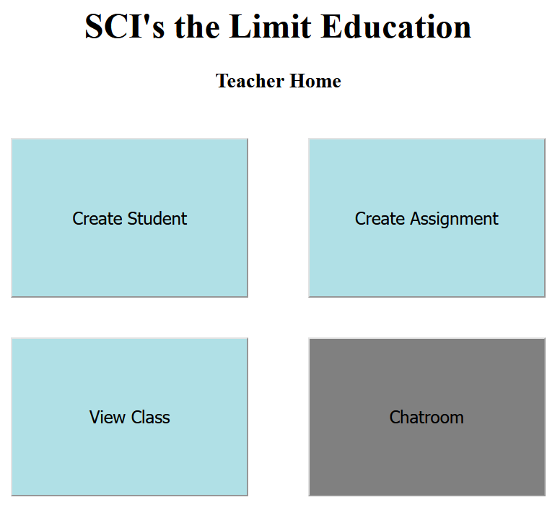
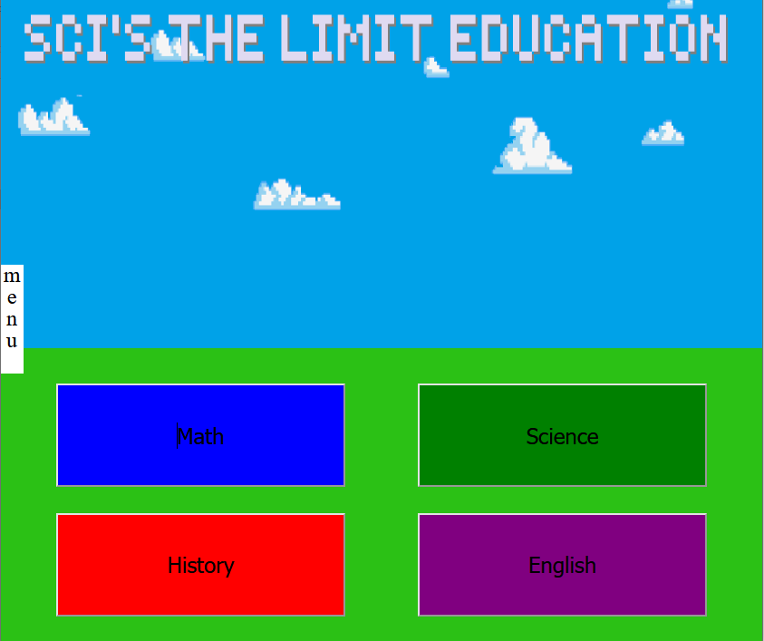
Prominent Features
Teacher interface simple and easy to use
Student homepage has easy access to assignments
Organized by subject

Slide 4
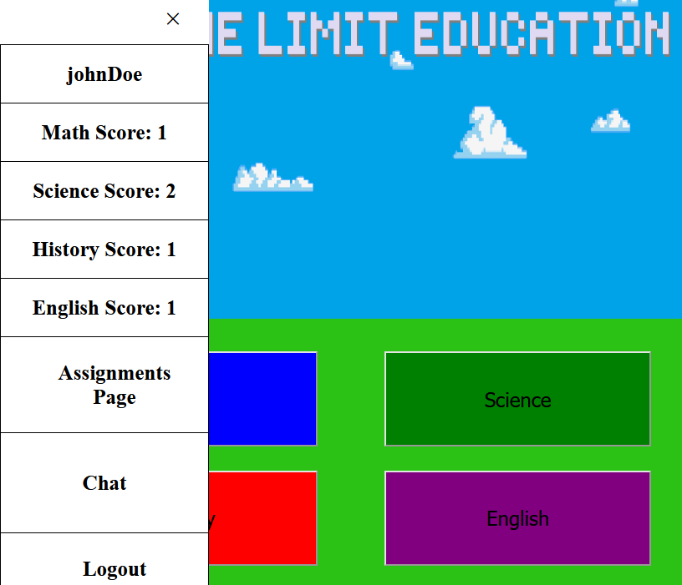
Prominent Features
Pull out side menu provides quick access to student scoreboard

Slide 5
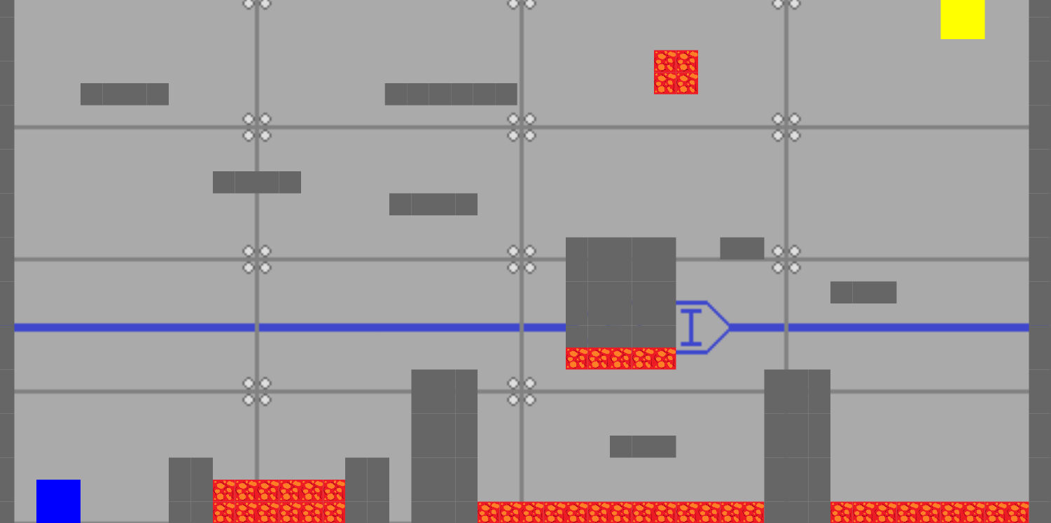
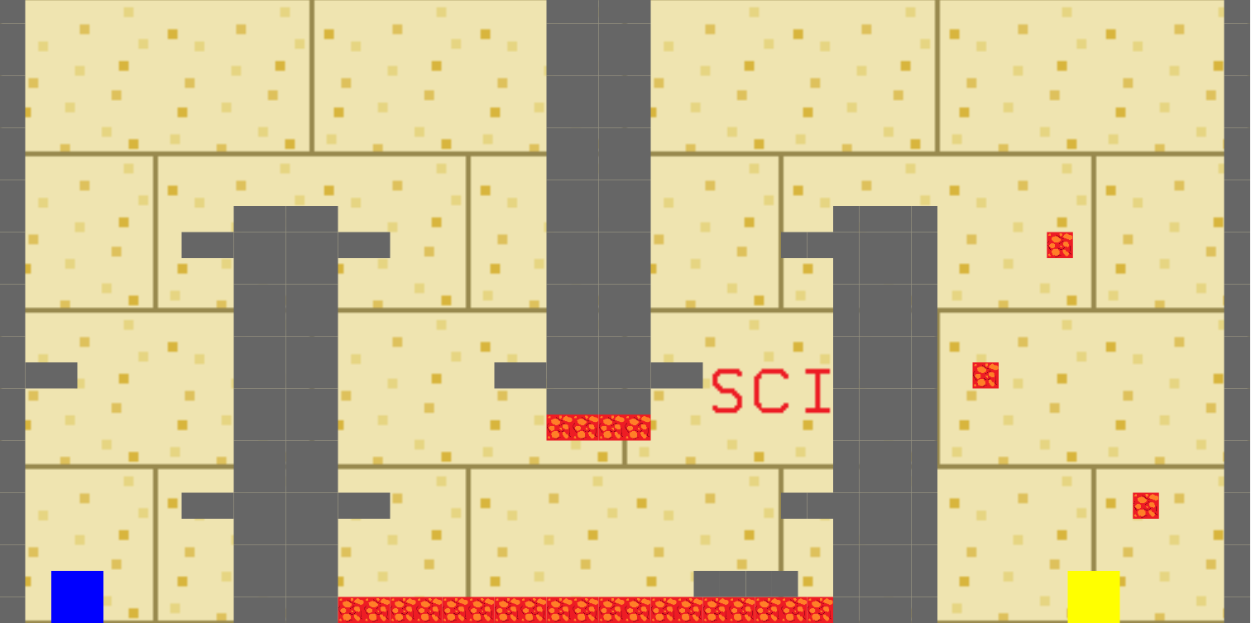
Prominent Features
Players navigate traps and obstacles to get the next assignment question

Slide 6
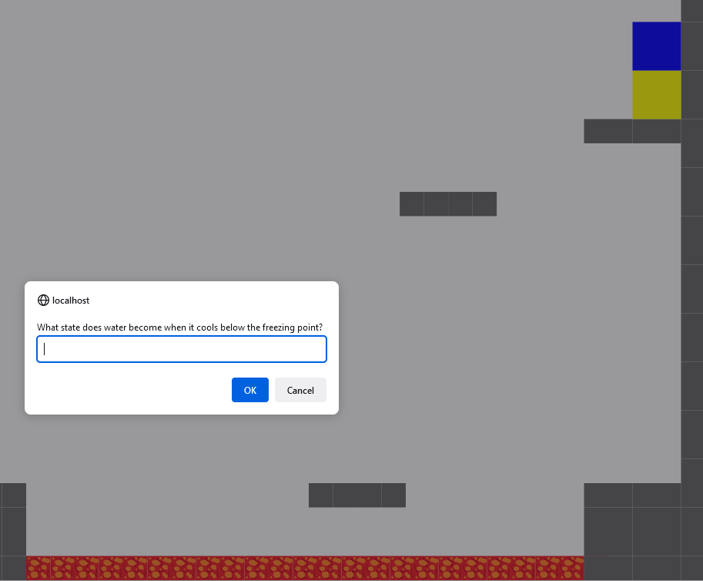
Prominent Features
Final task in every level is a subject based question chosen by teacher
Completing all levels / answering all questions For assignment gives student one point

Slide 7
Roles & Responsibilities
Zachary Ogren | Team Lead and front end development –website, game, user manual, back end assistance (php, SQL), testing, sales
John Lovre | Back end coordinator - Database (SQL), PowerPoint presentations, testing, sales
Birizibe Gnassingbe | Project Manager & Testing Lead - IC cards, documentation, module design (OOD), sales
Florian Reihl | Documentation manager - Data flow diagrams, use case diagrams, functional models, testing, sales

